Slide 1

FAKE NEWS DETECTION
Group-17
Bandi Kaushik(111901015)
Vikas naik(111901052)
M A Azeem(111901032)

Slide 2
Introduction
Fake news is a type of yellow journalism, it encapsulates pieces of news that may be hoaxes and is generally spread through social media and other online media
Fake news stories usually spread through social media sites like Facebook, Twitter etc
This is often done to further or impose certain ideas and is often achieved with political agendas.

Slide 3
Types of Fake News
Visual Based : Visual based fake news are mainly photoshopped images and videos which are posted on social media.
Linguistic Based: Linguistic based fake news are mainly based on manipulation of text and string content. This issue is generally found in emails, blogs etc.

Slide 4
Major problems of Fake news
By clicking clickbait, users are led to page that contains fake information
Fake news influences people’s perceptions
The rise of Fake news has become a global problem that even major tech companies like Facebook and google are struggling to solve. It can be difficult to determine whether a text is factual without additional context and human judgement.

Slide 5
Purpose
This project aims to develop a method for detecting and classifying Fake news stories using Natural Language Processing.
The main goal is to identify Fake news, which is a classic text classification issue.
We gathered our data, pre-process the text and translate our articles into supervised model features.
To develop a model that classifies a given news article as either true or fake
To identify the best classifier for this problem with the help of an accuracy, precision, Recall and F1_score

Slide 6
Steps involve
Data set loading
Data Pre-Processing(removing Stopwords, Stemming, Drop duplicate and remove meaningless char from the text.)
Vectorization( representing in numeric format)
Applying Classification and model construction( to predict the output)
Finding the Result

Slide 7
Dataset
The main structure of the dataset is like:
For our project we have collect two csv files: True.csv and Fake.csv
Here is the university link : https://www.uvic.ca/ecs/ece/isot/datasets/fake-news/index.php?utm_medium=redirect&utm_source=/engineering/ece/isot/datasets/fake-news/index.php&utm_campaign=redirect-usage
TITLE | TEXT | SUBJECT | DATE
……. | ……. | news | Month date, year
……. | …….. | politics | ……..
…… | ……. | Government News | ……..
……. | ……. | left-News | ……..
…… | ……. | Us_News | ……..
…….. | …….. | Middle-east | ………

Slide 8
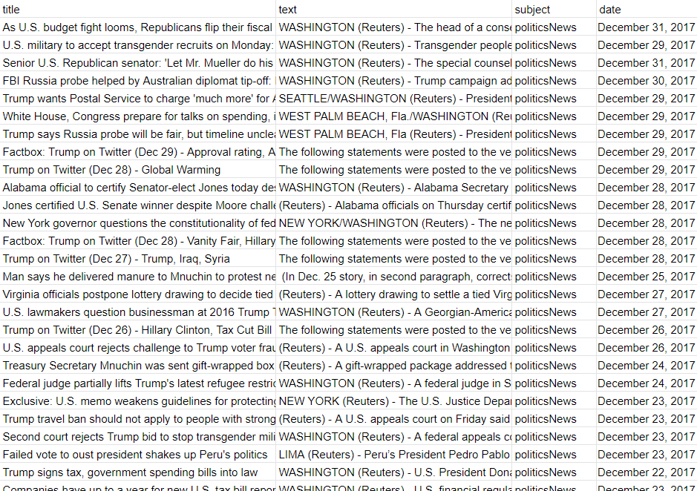
Dataset
True csv
It contains all real
news

Slide 9
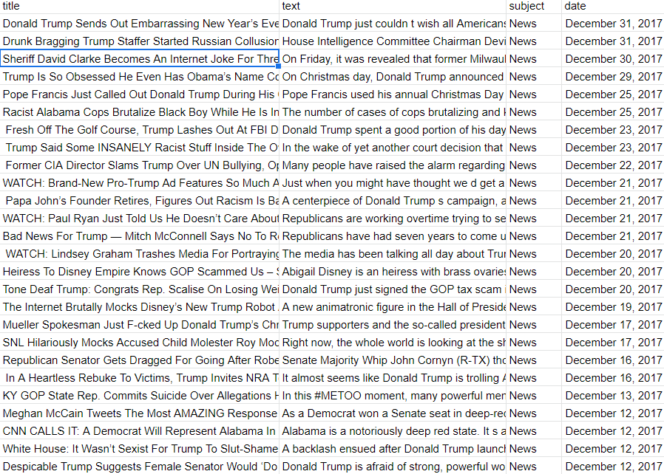
Dataset
Fake csv
It contains all fake
news

Slide 10
Dataset
Then we have added a column label to both the csv files and labelled fake and real for fake.csv and true.csv files respectively.
Then we concatenated the two csv files and suffled the data to use for our project.

Slide 11
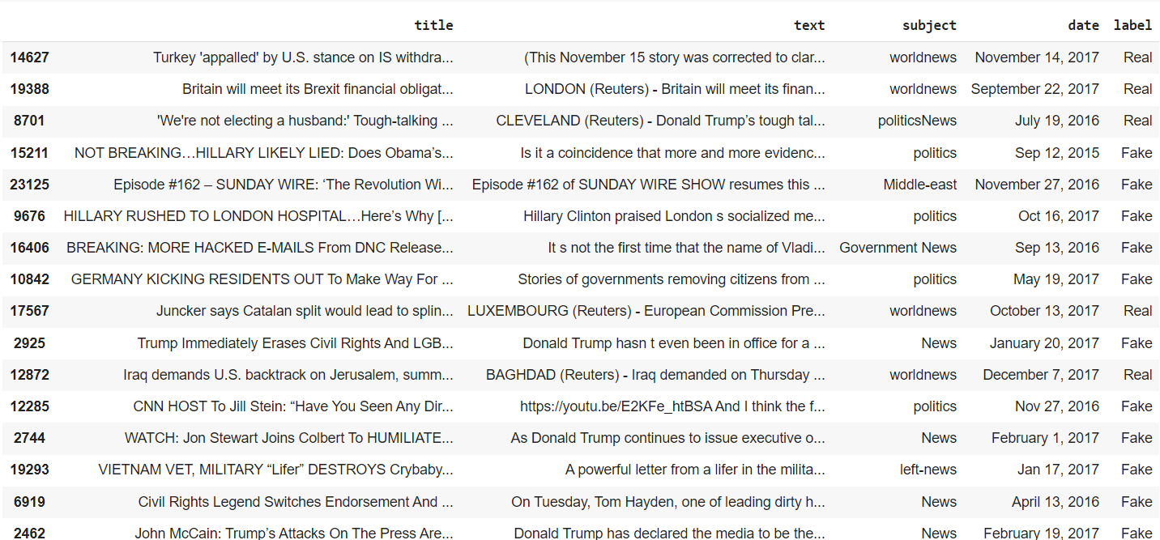
Dataset

Slide 12
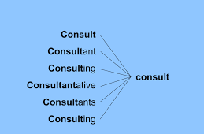
Text Processing
In this process we perform stemming, removal of stopwords, duplicate drops, and even removing nonsensical characters in the text, such as exclamation marks and commas.
Stemming is the process of reducing a word to its root.

Slide 13
TF-IDF Vectorization
TF (Term Frequency): The number of times a word appears in a document is its Term Frequency. A higher value means a term appears more often than others, and so, the document is a good match when the term is part of the search terms.
IDF (Inverse Document Frequency): Words that occur many times a document, but also occur many times in many others, may be irrelevant. IDF is a measure of how significant a term is in the entire corpus.
The TfidfVectorizer converts a collection of raw documents into its feature vectors.

Slide 14
Architecture
Extract the features from the pre-processed data using tfidf vectorization
Split the dataset into training and testing data
Using classification algorithm train the model with features extracted training data
Test and validate the model with the test data
We use Passive Aggressive Classifier, KNN Classifier, Multinomial Naive Bayes and Logistic Regression model and validate the data loaded.

Slide 15
Multinomial Naive Bayes Classifier
It is a Naive Bayes classifier for multinomial models.
It is suitable for classification with discrete features.
It guesses the tag of a text using the Bayes theorem and calculates each tag’s likelihood for a given sample and outputs the tag with the greatest chance.
The multinomial naïve bayes classifier has been used to determine the category of document and make the prediction based on the regularity of words in the file.

Slide 16
Passive Aggressive Algorithm
PA algorithms are generally used for large-scale learning
Such an algorithm remains passive for a correct classification outcome and turns aggressive in the event of miscalculations, updating and adjusting. Unlike most algorithm, it does not converge
Its purpose is to make updates that correct the loss, causing very little change in the norm of weight vector
It is one of the few ‘online-learning algorithms’

Slide 17
KNN Classifier
KNN Classifier determines the class of a data point by majority voting principle.
It calculates the distance from all points in the proximity of the unknown data and filters out the ones with the shortest distances to it.
Based on the distance it classifies whether the data is fake or real.

Slide 18
Logistic Regression
Logistic Regression is a classification algorithm used to assign observations to a discrete set of classes.
It is used for data that is co-dependent on each other, such as heads or tails.
It is used to capture the relation between the binary valued data and convert that into a function based on one dependent variable and one or more independent variables.
It is also used to predict the probability of a target variable.

Slide 19
Results
 | Accuracy | Precision | Recall | F1_Score
Multinomial Naive Bayes Classifier | 92.81% | 93.21% | 94.20% | 93.70
Passive Aggressive Classifier | 99.44% | 99.51% | 99.34% | 99.42%
KNN Classifier | 70.18% | 63.84% | 97.49% | 77.15%
Logistic Regression | 98.53% | 98.82% | 98.47% | 98.65%

Slide 20
Conclusion
We used TF-IDF Vectorization and have implemented the Fake News Detection model using the Passive-Aggressive Classifier, Multinomial Naive Bayes Classifier, K Nearest Neighbor Classifier, and Logistic Regression Classifier.
Passive Aggressive Classifier has high accuracy as compared to other classifier models and selected this model to detect fake news detection. So overall, the performance for our dataset was better with Passive Aggressive Classifier. Also, the confusion matrix has been plotted and Accuracy, Precision, Recall, and f1_score values have been measured for the performance of the analysis purpose.

